Slide 1

Stochastic algorithms (i.e. probability and statistics applied to algorithms)

Slide 2
Motivation
Most processes in the world are probabilistic (i.e. not deterministic).
That is, several outcomes are possible but none are hardcoded.
When the process is repeated a large number of times, each outcome occurs with a characteristic relative frequency, or probability.
If a particular outcome happens more often than another outcome, we say it is more probable.
Stochastic algorithms exploit probability theory to solve deterministically-intractable computational problems

Slide 3
Motivating example
Let’s imagine the following scenario:
1% of the population has cancer (99% does not)
80% of cancer tests (mammograms, colonoscopies, etc.) detect cancer when it is there (20% miss it)
9% of cancer tests detect cancer when it is not there (therefore, 91% correctly return a negative result)
You do a test on yourself and you get a “positive” test result (cancer diagnosis).
How worried should you be?
That is, what are the chances you have cancer?
80%? 91%? 99%, 8% so not too worried at all?
To correctly answer this question, we need to study probability theory
The logic of science

Slide 4
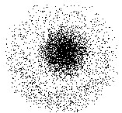
Probability spaces
You can think of a probability space as a probability cloud of a random process or experiment
It has three components:
Ω, the set of possible outcomes O
number of possible outcomes = | Ω | = N
F, the set of possible events E
an event comprises 0 to N outcomes
number of possible events = | F | = 2^{N}
P, the probability distribution
function mapping each outcome and event to real number between 0 and 1 (the probability of O or E)
probability of an event is the sum of probabilities of all possible outcomes in the event
Notes:
Probability cloud

Slide 5
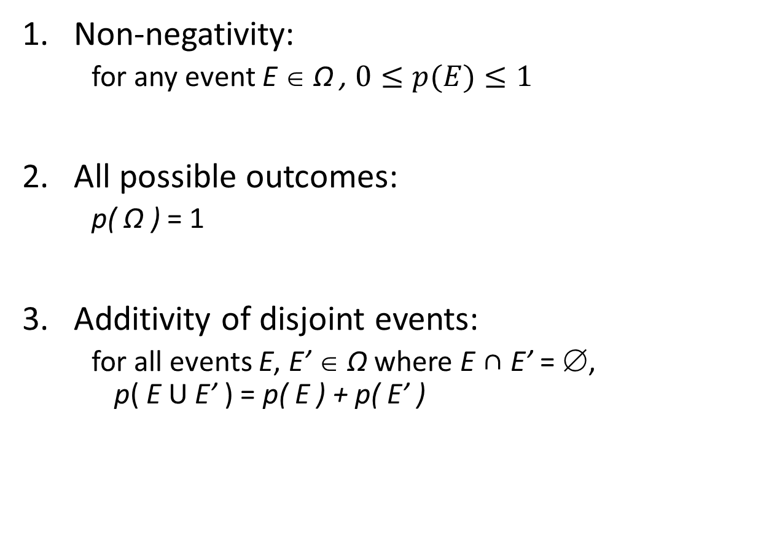
Axioms of probability
Non-negativity:
for any event E ∈ Ω , $0≤p(E)≤1$
All possible outcomes:
p( Ω ) = 1
Additivity of disjoint events:
for all events E, E’ ∈ Ω where E ∩ E’ = ∅, p( E U E’ ) = p( E ) + p( E’ )
Notes:
Role of axioms in mathematics

Slide 6
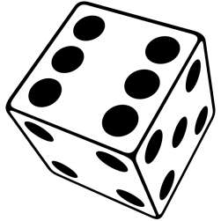
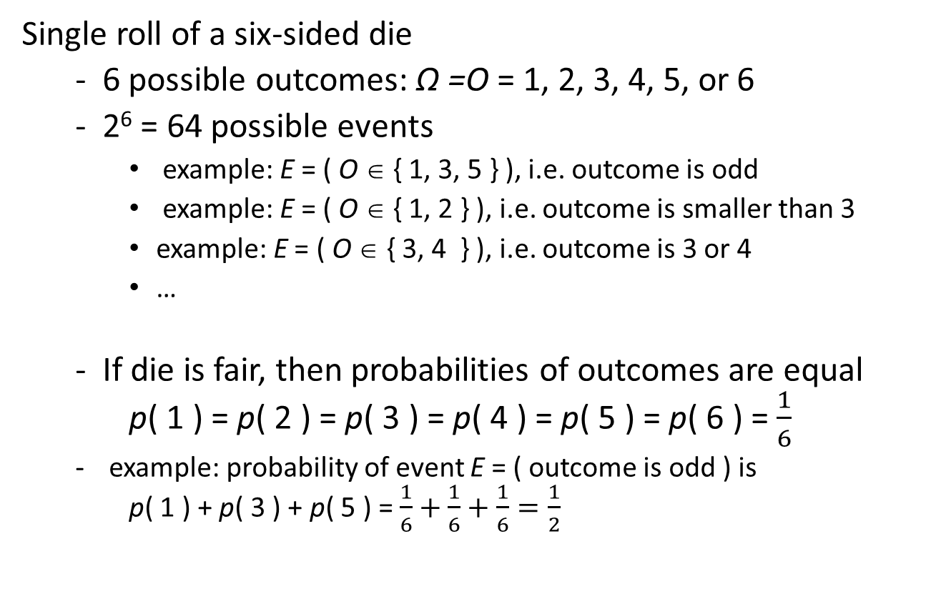
Example of discrete probability space
Single roll of a six-sided die
6 possible outcomes: Ω =O = 1, 2, 3, 4, 5, or 6
2⁶ = 64 possible events
example: E = ( O ∈ { 1, 3, 5 } ), i.e. outcome is odd
example: E = ( O ∈ { 1, 2 } ), i.e. outcome is smaller than 3
example: E = ( O ∈ { 3, 4 } ), i.e. outcome is 3 or 4
…
If die is fair, then probabilities of outcomes are equal p( 1 ) = p( 2 ) = p( 3 ) = p( 4 ) = p( 5 ) = p( 6 ) = $\frac{1}{6}$
example: probability of event E = ( outcome is odd ) is p( 1 ) + p( 3 ) + p( 5 ) = $\frac{1}{6}+\frac{1}{6}+\frac{1}{6}=\frac{1}{2}$

Slide 7
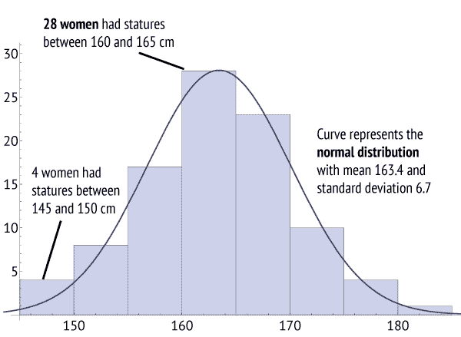
Example of continuous probability space
Height of a randomly chosen New Zealand adult female can be modeled with a probability distribution
There is an infinite number of possible outcomes: O has some single value roughly in range 140 cm to 200 cm
Infinite number of possible events
example: E = ( O | O < 170 cm), i.e. individual chosen is less than 170 cm tall
Probabilities of outcomes are not equal, and are described by a continuous function, p( O )

Slide 8
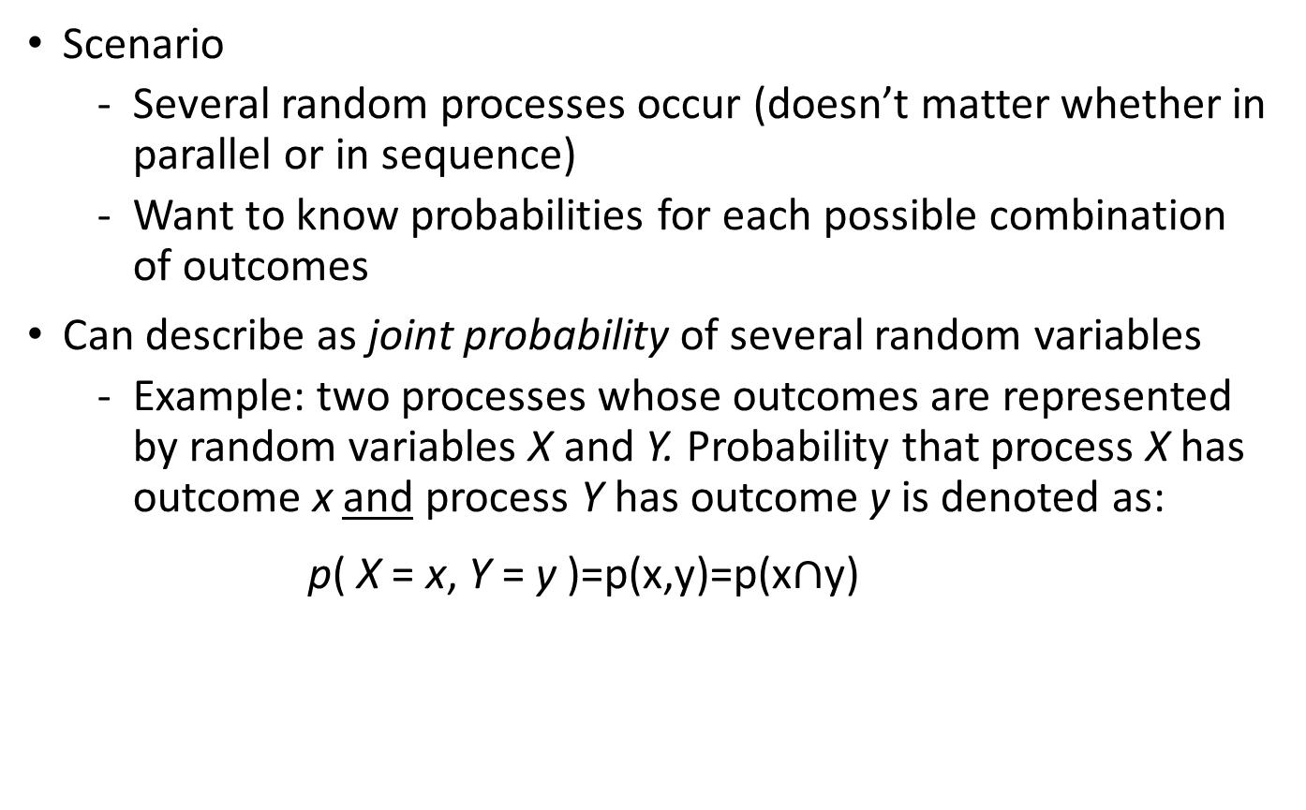
Multivariate probability distributions
Scenario
Several random processes occur (doesn’t matter whether in parallel or in sequence)
Want to know probabilities for each possible combination of outcomes
Can describe as joint probability of several random variables
Example: two processes whose outcomes are represented by random variables X and Y. Probability that process X has outcome x and process Y has outcome y is denoted as:
p( X = x, Y = y )=p(x,y)=p(x$∩$y)

Slide 9

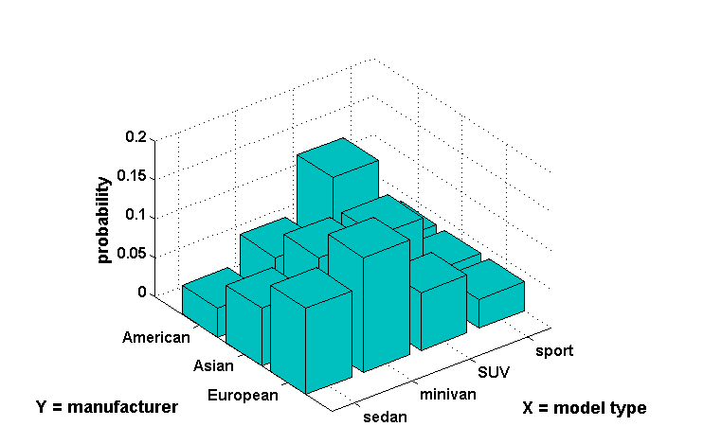






Example of multivariate distribution
joint probability: p( X = minivan, Y = European ) = 0.1481
Notes:
Discrete example

Slide 10
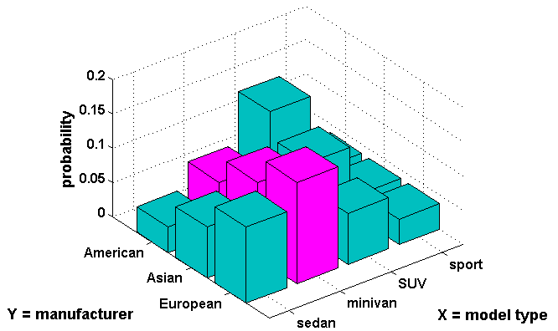
Marginal probability
Probability distribution of a single variable in a joint distribution
Example: two random variables X and Y:
p( X = x ) = ∑_{b=all values of Y} p( X = x, Y = b )
marginal probability: p( X = minivan ) = 0.0741 + 0.1111 + 0.1481 = 0.3333

Slide 11
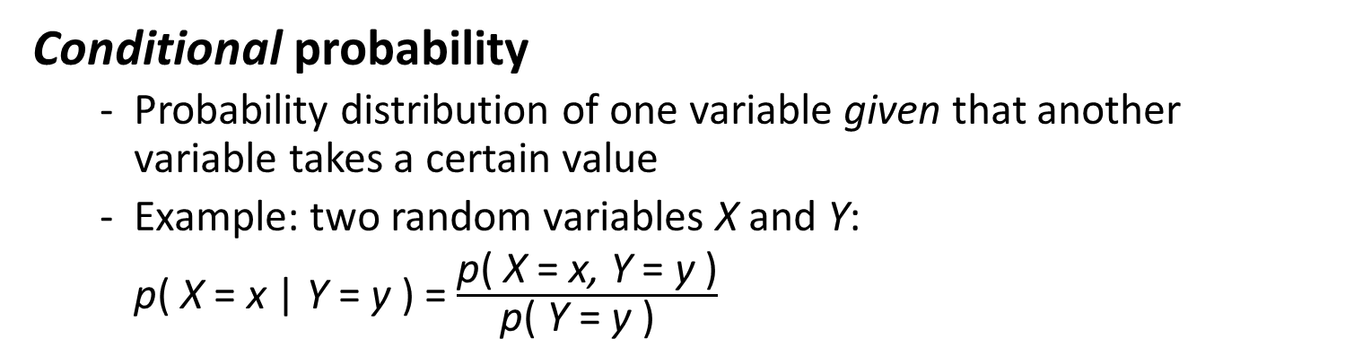
Conditional probability
Probability distribution of one variable given that another variable takes a certain value
Example: two random variables X and Y:
p( X = x | Y = y ) = $\frac{\text{p}\text{( }\text{X}\text{ = }\text{x}\text{,} \text{Y}\text{ = }\text{y}\text{ )}}{\text{p}\text{( }\text{Y}\text{ = }\text{y}\text{ ) }}$
0.2
0.15
probability
0.1
0.05
0
American
sport
Asian
SUV
Y = manufacturer
European
minivan
X = model type
sedan
conditional probability: p( Y = European | X = minivan ) = $\frac{\text{0.1481}}{\text{( 0.0741 + 0.1111 + 0.1481 )}}$ = 0.4433

Slide 12
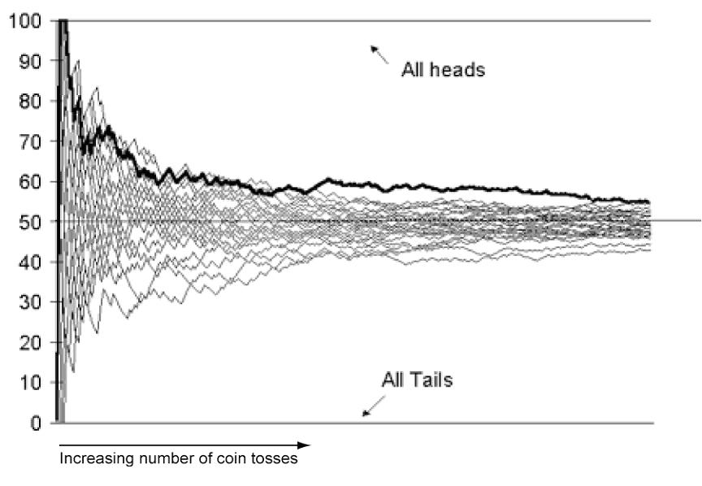
Expected value
Given:
A discrete random variable X,
with possible values x = x₁, x₂, … x_{n}
Probabilities p( X = x_{i} ) that X takes on the various values of x_{i}
A function y_{i} = f( x_{i} ) defined on X
The expected value of f is the probability-weighted “average” value of f( x_{i} ):
E( f ) = ∑_{i} p( x_{i} ) ⋅ f( x_{i} )
i.e. long-term average
0
Notes:
Suppose you receive the following option.
You flip a fair coin.
If the coin is Heads, you acquire healthy immortality.
If the coin is Tails, you instantly die.
The expected value of this option seems infinite: $0.5×∞+0.5×0=∞$

Slide 13
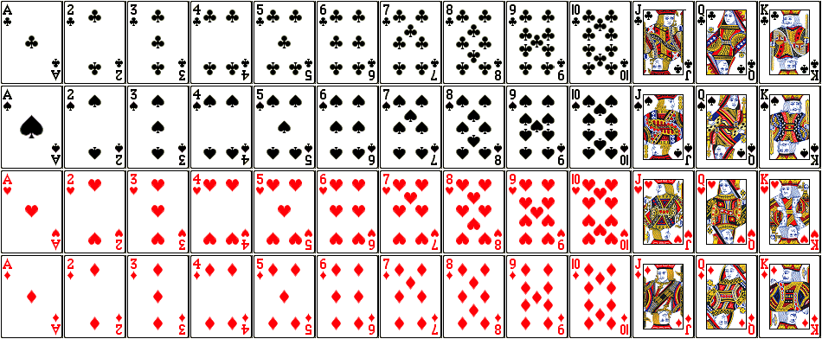
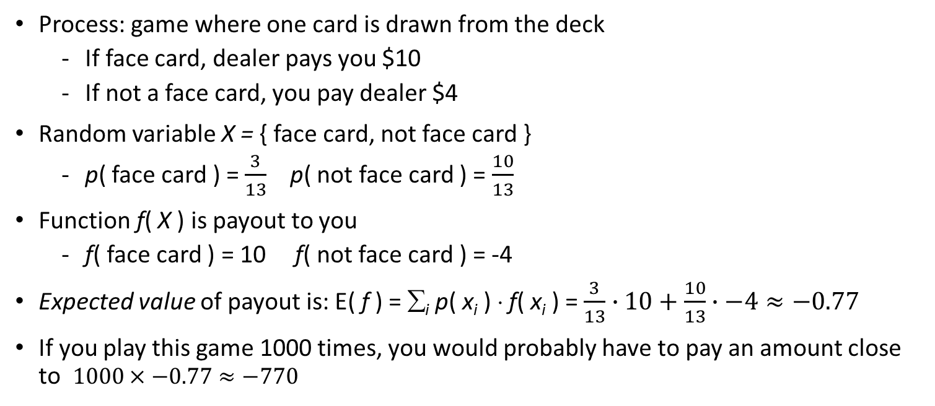
Example of expected value
Process: game where one card is drawn from the deck
If face card, dealer pays you $10
If not a face card, you pay dealer $4
Random variable X = { face card, not face card }
p( face card ) = $\frac{3}{13}$ p( not face card ) = $\frac{10}{13}$
Function f( X ) is payout to you
f( face card ) = 10 f( not face card ) = -4
Expected value of payout is: E( f ) = ∑_{i} p( x_{i} ) ⋅ f( x_{i} ) = $\frac{3}{13}∙10+\frac{10}{13}∙−4≈−0.77$
If you play this game 1000 times, you would probably have to pay an amount close to $1000×−0.77≈−770$

Slide 14
Complement rule
Given: event A, which can occur or not
p( not A ) = 1 - p( A )
Ω
A
not A
areas represent relative probabilities
Notes:
Same expression given previously to define conditional probability.
Example of two events which can co-occur (or not): flips of two coins.

Slide 15
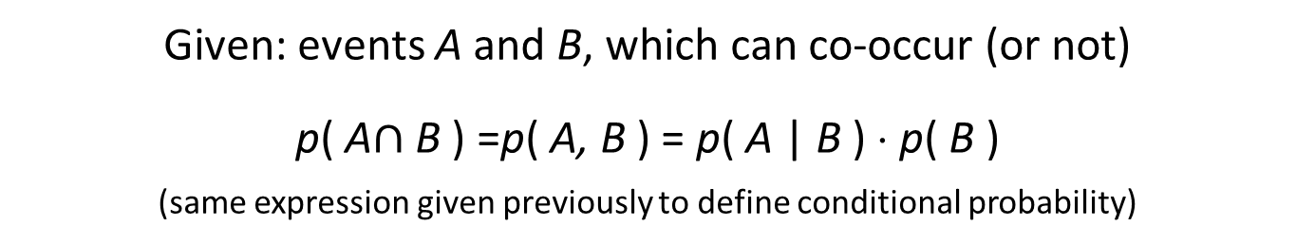
Product rule
Given: events A and B, which can co-occur (or not)
p( A$∩$ B ) =p( A, B ) = p( A | B ) ⋅ p( B )
(same expression given previously to define conditional probability)
(not A, not B)
A
B
( A, B )
Ω
(A, not B)
(not A, B)
areas represent relative probabilities
Notes:
Same expression given previously to define conditional probability.
Example of two events which can co-occur (or not): flips of two coins.

Slide 16
Rule of total probability
Given: events A and B, which can co-occur (or not)
p( A ) = p( A, B ) + p( A, not B )
(same expression given previously to define marginal probability)
(not A, not B)
A
B
( A, B )
Ω
(A, not B)
(not A, B)
areas represent relative probabilities
Notes:
Same expression given previously to define marginal probability.
Also known as sum rule.

Slide 17
Independence (events are independent from each other)
Given: events A and B, which can NOT co-occur
p( A | B ) = p( A ) or p( A, B ) = p( A ) ⋅ p( B )
Ω
(not A, not B)
(not A, B)
B
(A, not B)
A
( A, B )
areas represent relative probabilities

Slide 18
Examples of independet / dependent events
Independence:
Outcomes on multiple rolls of a die
Outcomes on multiple flips of a coin
Height of two unrelated individuals
Probability of getting a king on successive draws from a deck, if card from each draw is replaced and deck shuffled
Dependence:
Height of two related individuals (i.e. father and son)
Duration of successive eruptions in Geyser
Probability of getting a king on successive draws from a deck, if card from each draw is not replaced
Think about this and make sure you understand the rationale

Slide 19
Example of independence vs. dependence
Independence: All manufacturers have identical product mix. p( X = x | Y = y ) = p( X = x ).
Dependence: American manufacturers love SUVs, Europeans manufacturers don’t.

Slide 20
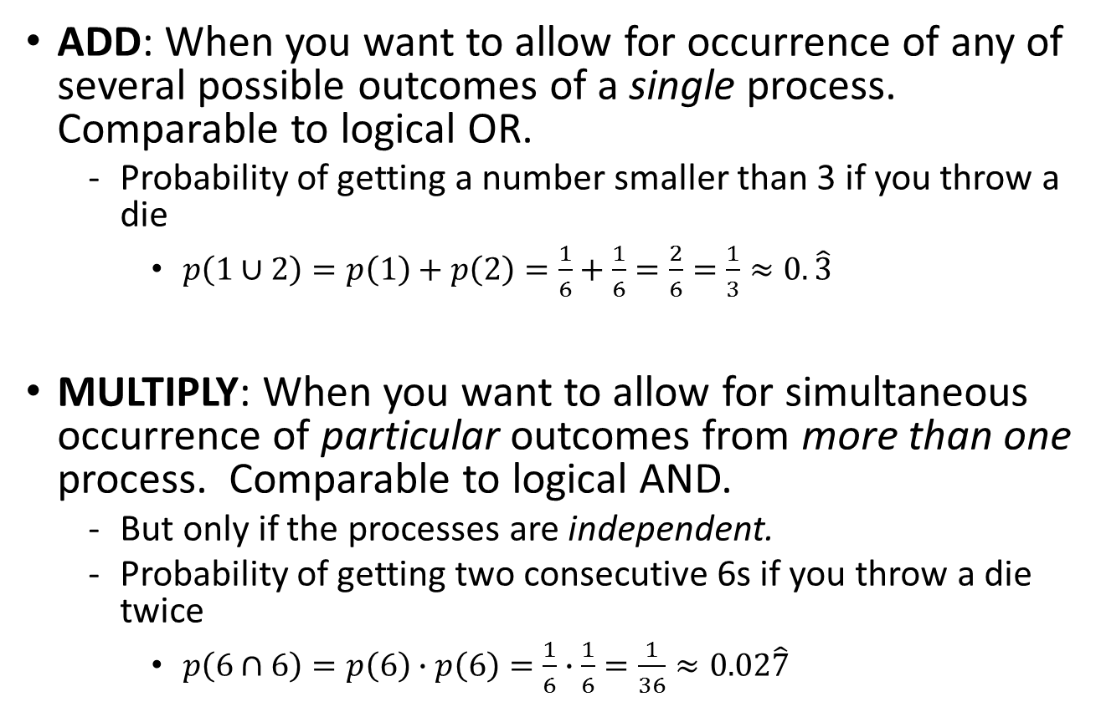
Probabilities: when to add, when to multiply
ADD: When you want to allow for occurrence of any of several possible outcomes of a single process. Comparable to logical OR.
Probability of getting a number smaller than 3 if you throw a die
$p\left(1∪2\right)=p\left(1\right)+p\left(2\right)=\frac{1}{6}+\frac{1}{6}=\frac{2}{6}=\frac{1}{3}≈0.\hat{3}$
MULTIPLY: When you want to allow for simultaneous occurrence of particular outcomes from more than one process. Comparable to logical AND.
But only if the processes are independent.
Probability of getting two consecutive 6s if you throw a die twice
$p\left(6∩6\right)=p\left(6\right)∙p\left(6\right)=\frac{1}{6}∙\frac{1}{6}=\frac{1}{36}≈0.02\hat{7}$

Slide 21

Monte Carlo algorithms
A broad class of computational algorithms that rely on repeated random sampling to obtain numerical results whose output may be incorrect with a certain (typically small) probability
Notes:
The underlying concept is to use randomness to solve problems that might be deterministic in principle.
They are often used in physical and mathematical problems and are most useful when it is difficult or impossible to use other approaches.
Monte Carlo methods are mainly used in three problem classes: optimization, numerical integration, and generating draws from a probability distribution.
In physics-related problems, Monte Carlo methods are useful for simulating systems with many coupled degrees of freedom, such as fluids, disordered materials, strongly coupled solids, and cellular structures, interacting particle systems, McKean–Vlasov processes, kinetic models of gases).
Other examples include modeling phenomena with significant uncertainty in inputs such as the calculation of risk in business and, in mathematics, evaluation of multidimensional definite integrals with complicated boundary conditions.
In application to systems engineering problems (space, oil exploration, aircraft design, etc.), Monte Carlo–based predictions of failure, cost overruns and schedule overruns are routinely better than human intuition or alternative "soft" methods

Slide 22
Monte Carlo algorithms
Monte Carlo algorithms vary, but tend to follow a particular pattern:
Define a domain of possible inputs
Generate inputs randomly from a probability distribution over the domain
Perform a deterministic computation on the inputs
Aggregate the results

Slide 23
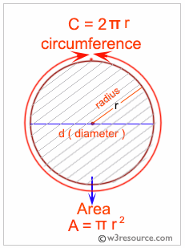
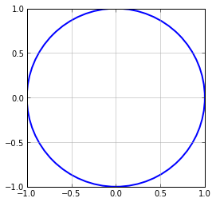
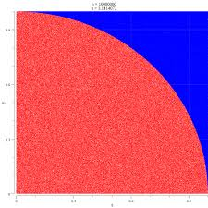
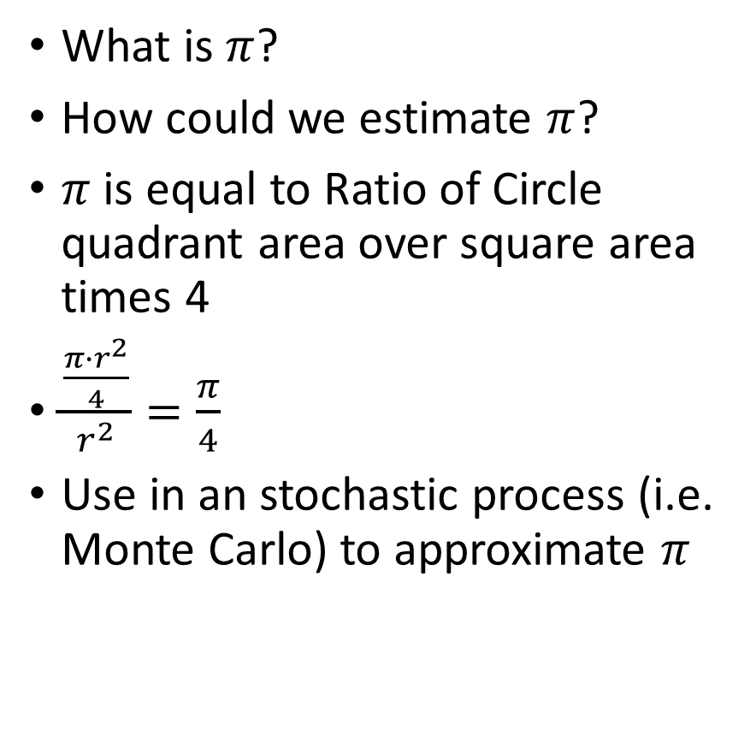

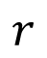
Estimating $π$ using a Monte Carlo algorithm
What is $π$?
How could we estimate $π$?
$π$ is equal to Ratio of Circle quadrant area over square area times 4
$\frac{\frac{π∙r^{2}}{4}}{r^{2}}=\frac{π}{4}$
Use in an stochastic process (i.e. Monte Carlo) to approximate $π$
$$r$$

Slide 24
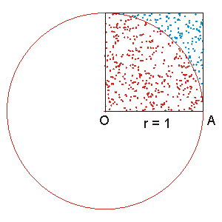
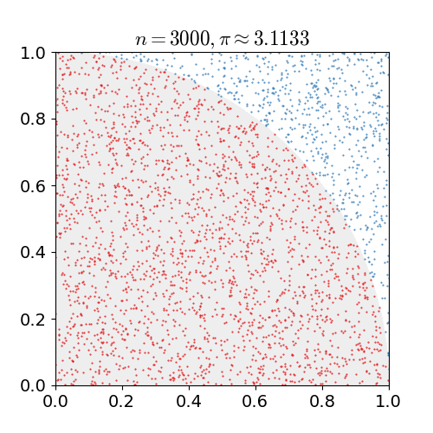
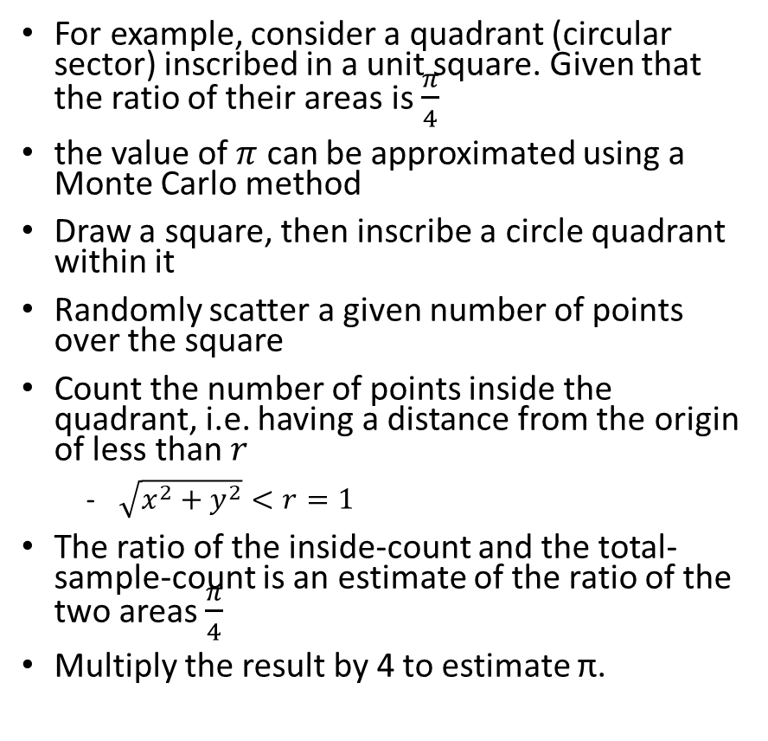

Monte Carlo algorithm for approximating $π$
For example, consider a quadrant (circular sector) inscribed in a unit square. Given that the ratio of their areas is $\frac{π}{4}$
the value of $π$ can be approximated using a Monte Carlo method
Draw a square, then inscribe a circle quadrant within it
Randomly scatter a given number of points over the square
Count the number of points inside the quadrant, i.e. having a distance from the origin of less than $r$
$\sqrt{x^{2}+y^{2}}<r=1$
The ratio of the inside-count and the total-sample-count is an estimate of the ratio of the two areas $\frac{π}{4}$
Multiply the result by 4 to estimate π.

Slide 25
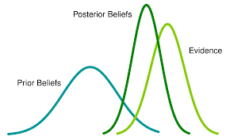
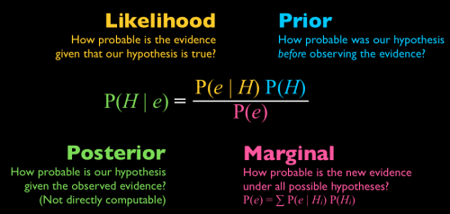
Bayes theorem
Bayesian probability is an interpretation of the concept of probability, in which, instead of frequency or propensity of some phenomenon, probability is interpreted as reasonable expectation representing a state of knowledge or as quantification of a personal belief.

Slide 26
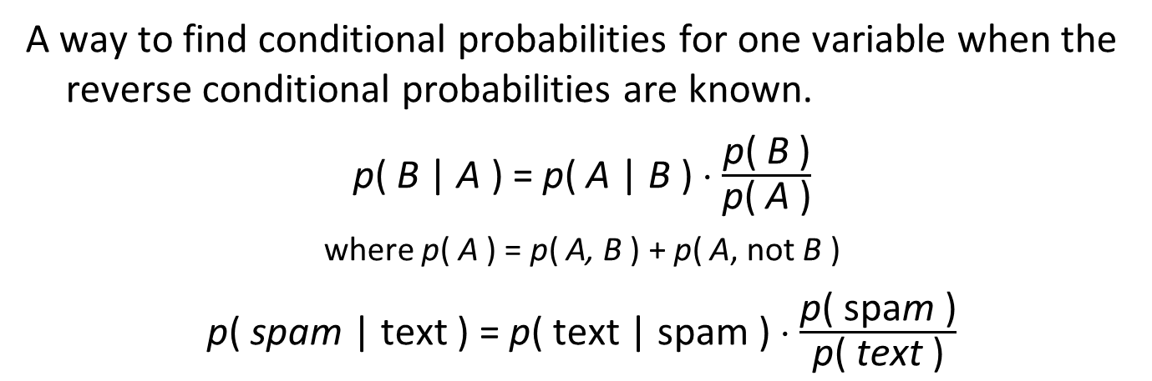
Bayes rule
A way to find conditional probabilities for one variable when the reverse conditional probabilities are known.
p( B | A ) = p( A | B ) ⋅ $\frac{\text{p}\text{( }\text{B}\text{ )}}{\text{p}\text{( }\text{A}\text{ )}}$
where p( A ) = p( A, B ) + p( A, not B )
p( spam | text ) = p( text | spam ) ⋅ $\frac{\text{p}\text{( }\text{spa}\text{m}\text{ )}}{\text{p}\text{( }\text{text}\text{ )}}$
(not A, not B)
A
B
( A, B )
Ω
(A, not B)
(not A, B)
Notes:
Combine product rule and rule of total probability.

Slide 27
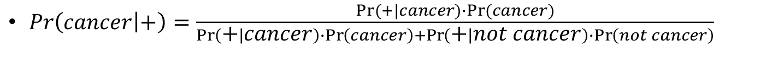
Using Bayes formula to calculate the probability of cancer given a positive diagnostics test
1% of the population has cancer ( 99% does not)
80% of cancer tests ( mammograms, colonoscopies, etc.) detect cancer when it is there ( 20% miss it)
9% of cancer tests detect cancer when it is not there (therefore, 91% correctly return a negative result)
Objective reality
 | Cancer (1%) | No cancer (99%)
Test + | 80% | 9%
Test - | 20% | 91%
Test results
$Pr\left(cancer | +\right)=\frac{Pr⁡(+|cancer)∙Pr⁡(cancer)}{\operatorname{Pr}\left(+ | cancer\right)∙\operatorname{Pr}\left(cancer\right)+\operatorname{Pr}\left(+ | not cancer\right)∙\operatorname{Pr}\left(not cancer\right)}$
$Pr\left(cancer | +\right)=\frac{0.80×0.01}{0.80×0.01+0.09×.99}=\frac{0.008}{0.008+0.089}=\frac{0.008}{0.097}=0.082→8\%$

Slide 28
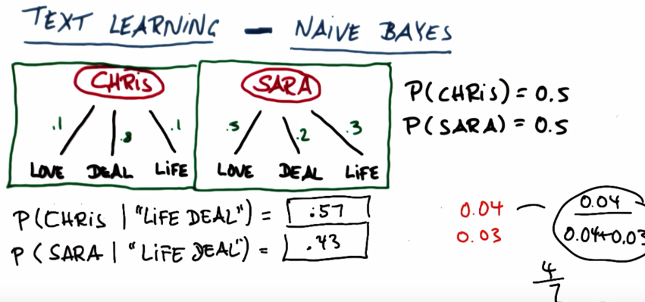
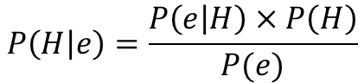
Naïve Bayes applied to text classification
Bayes theorem:
$$P\left(H | e\right)=\frac{P\left(e | H\right)×P\left(H\right)}{P(e)}$$
$$P\left(Chris | "Life Deal"\right)=\frac{P\left("Life Deal" | Chris\right)∗P\left(Chris\right)}{P\left("Life Deal" | Chris\right)+P\left("Life Deal" | Sara\right)}=\frac{\left(.1×.8\right).5}{\left(.1×.8\right)×.5+\left(.3×.2\right).5}=\frac{0.04}{0.04+0.03}=0.57$$
$$P\left(Sara | "Life Deal"\right)=\frac{P\left("Life Deal" | Sara\right)∗P\left(Sara\right)}{P\left("Life Deal" | Chris\right)+P\left("Life Deal" | Sara\right)}=\frac{\left(.3×.2\right).5}{\left(.1×.8\right)×.5+\left(.3×.2\right).5}=\frac{0.03}{0.04+0.03}=0.43$$
Notes:
imagine that Christopher and Sarah speak in a language that only uses 3 words: love, deal, and life.
However, Christopher and Sarah employ each of the words of the language with different frequencies.
Assuming that you know with which frequencies of words Christopher and Sarah speak, could you estimate the probability of a certain message coming from either Christopher or Sarah?
Bayes theorem allows you to do that.

